Slide 1
Visual Culture

Slide 2
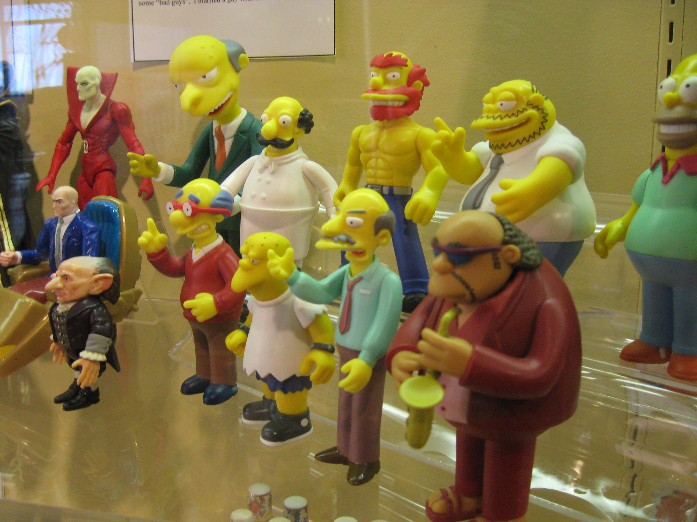
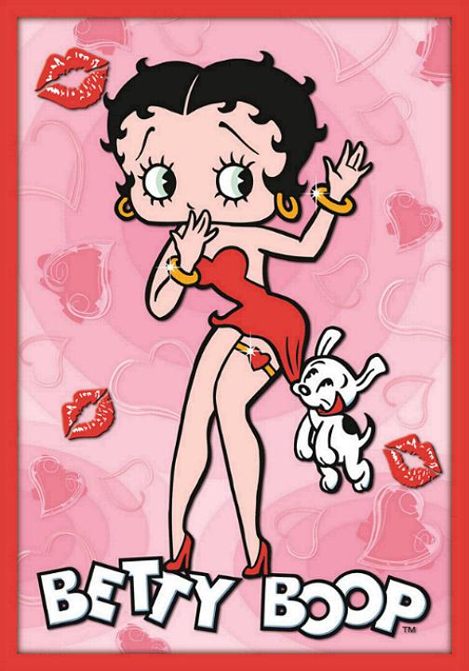

Slide 4
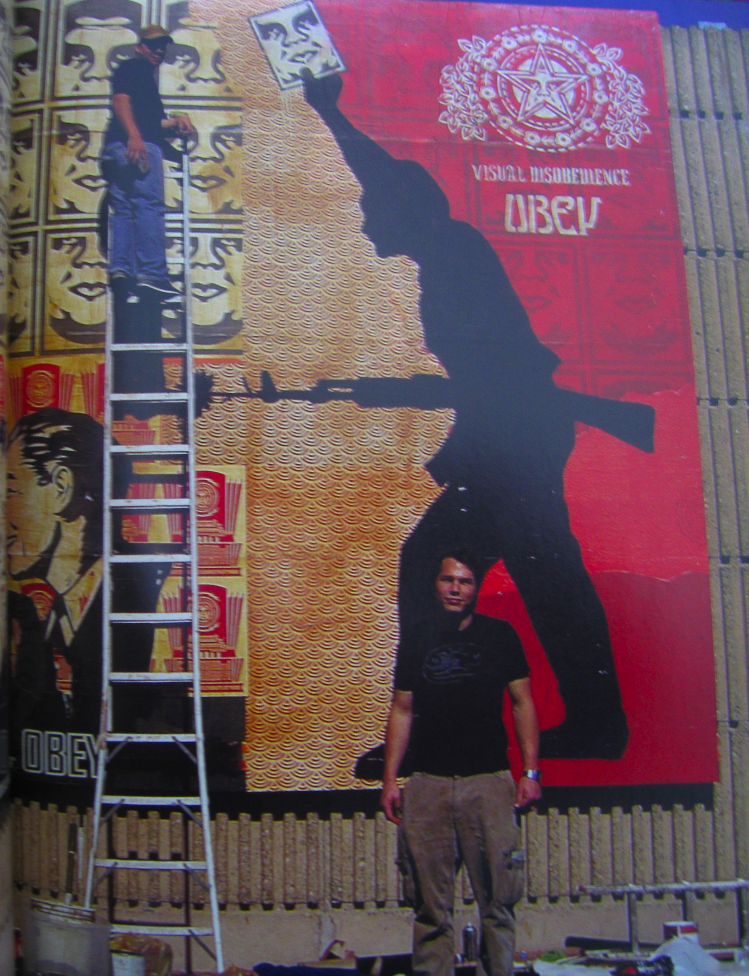
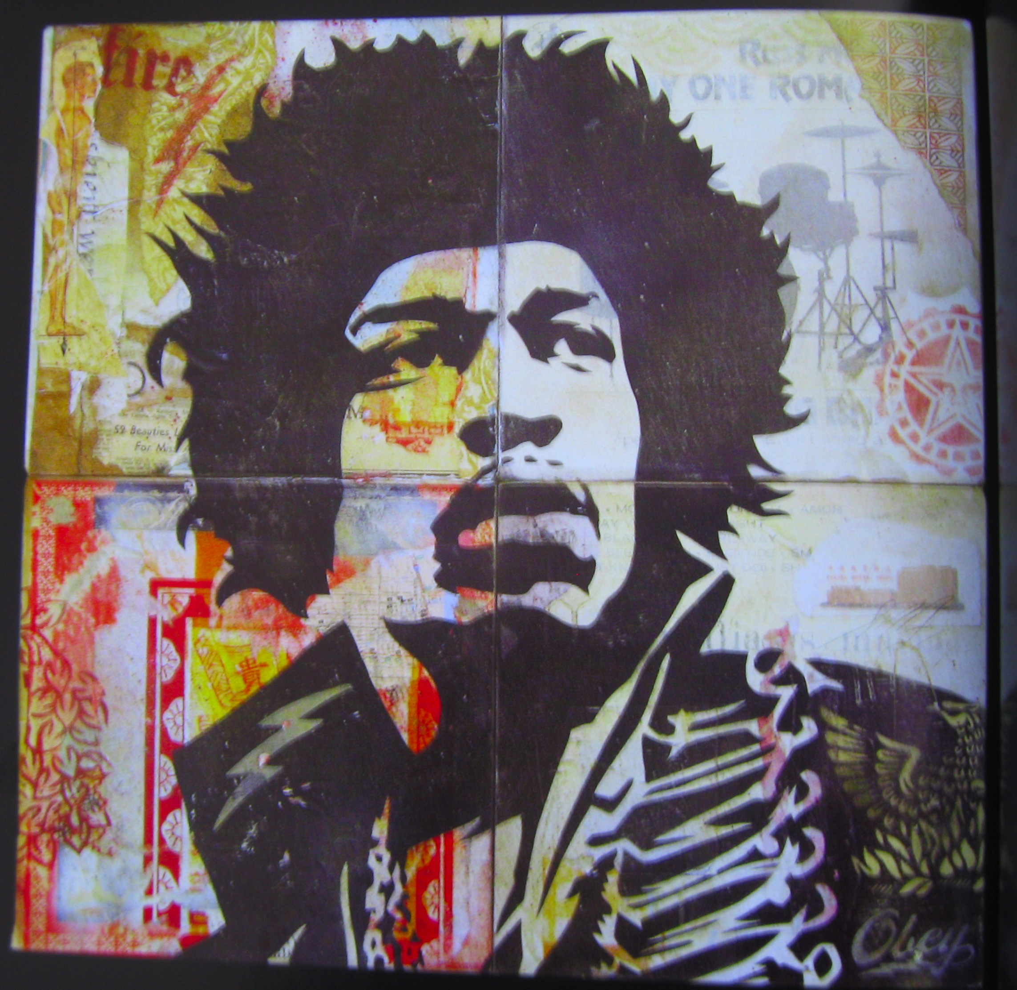
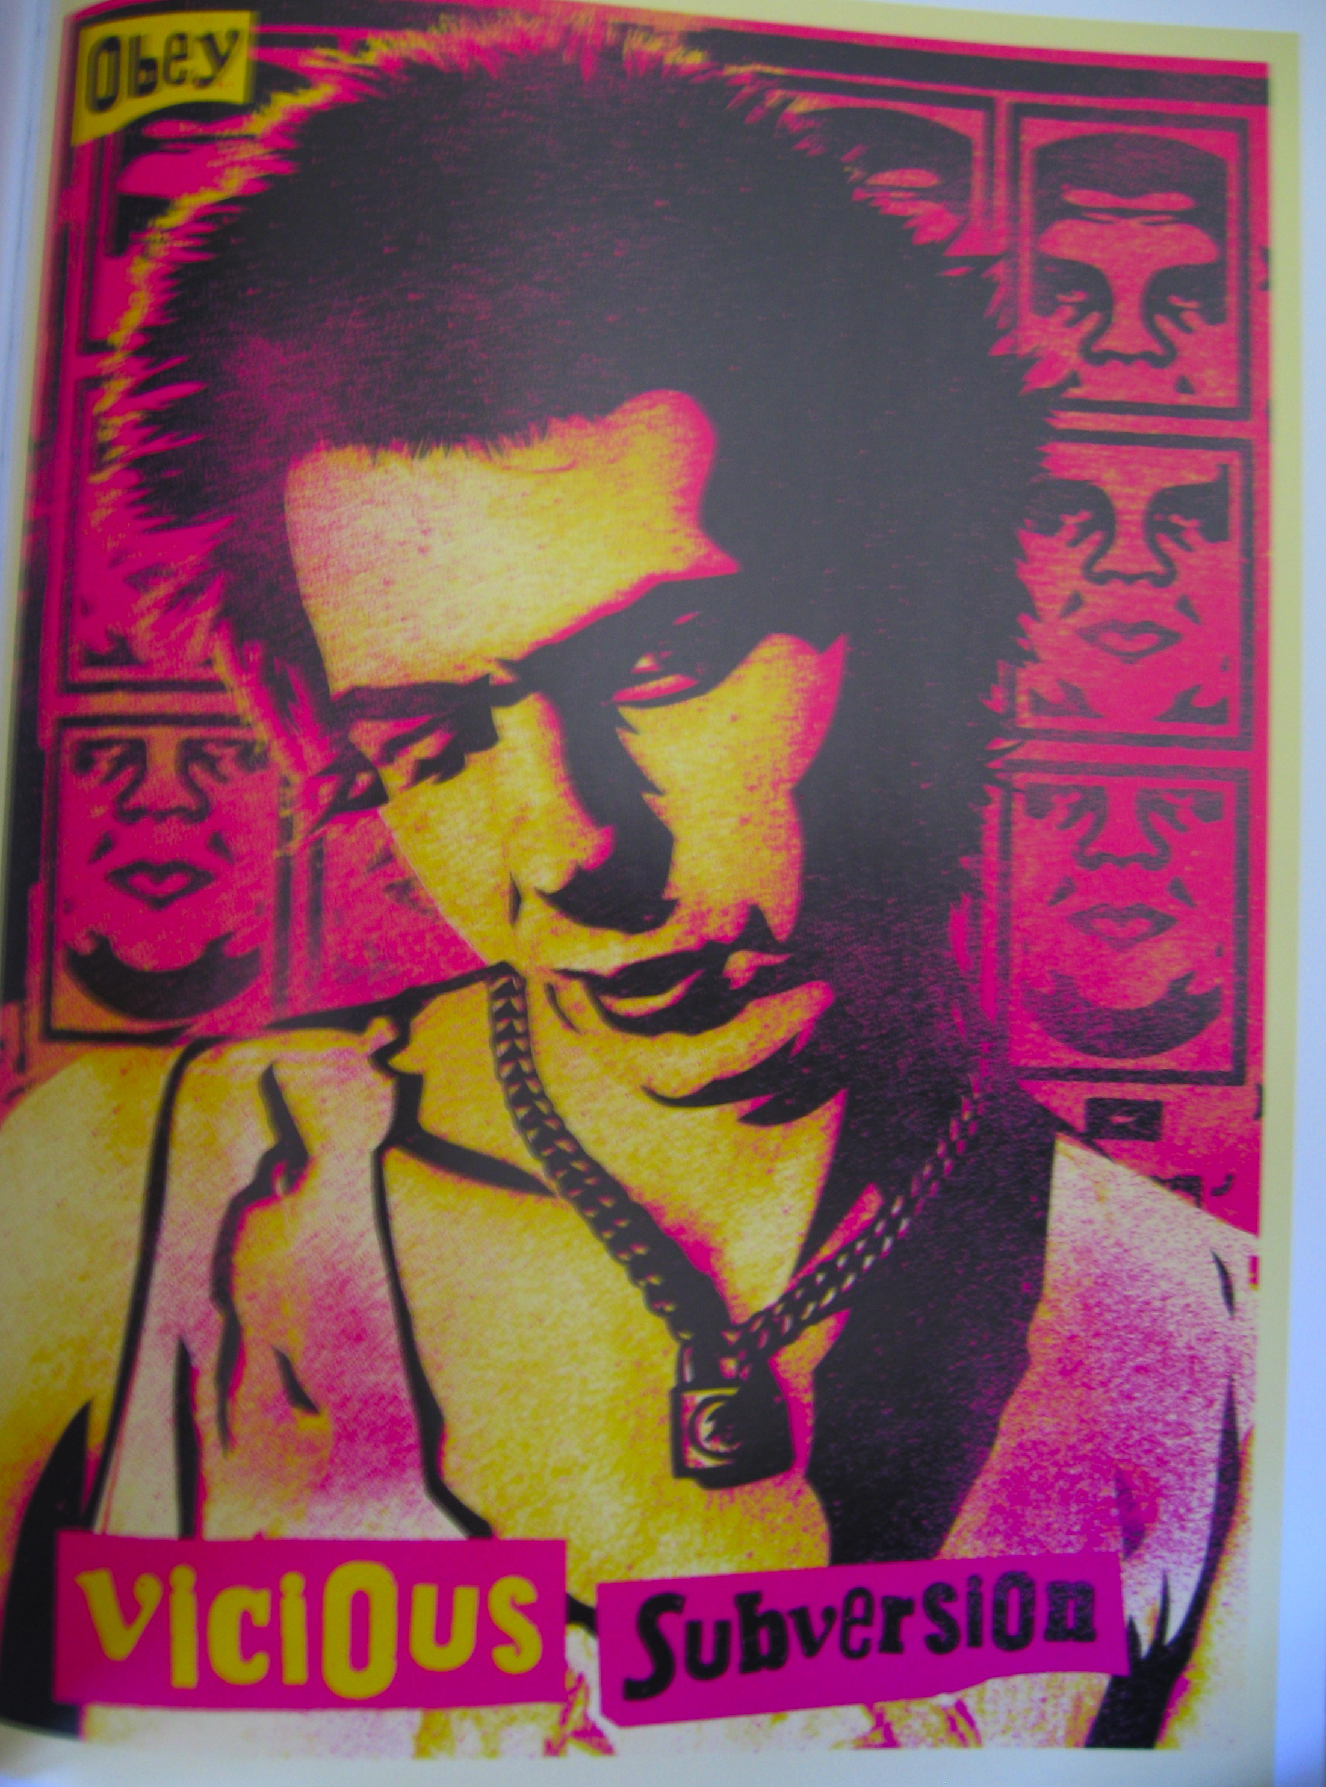

Slide 5
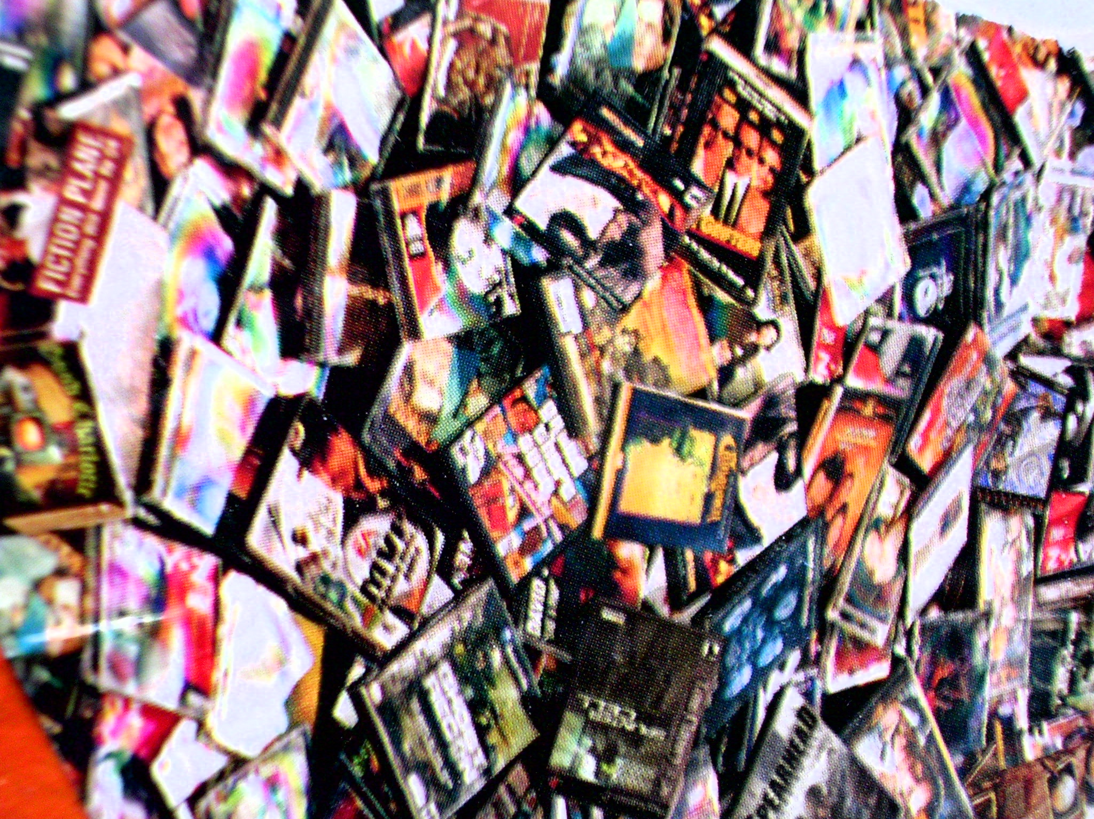
.
Interactive gaming
Malls
Music videos
Reality TV shows
_{VISUAL CULTURE}
Mp3s and
CDs
DVDs and
videos
Arcades and
video games
Film-cinemas
internet
Magazines
Notes:
In the past 15 years since I was a teen, there has been an increase in the abundance of images and the presence of new forms of media. Furthermore, corporate ownership has merged into fewer mega conglomorates making it difficult for alternative voices and resources to be funded and communicated to public audiences.
Youth Life is experienced through a dense sea of hypertexts that interconnect, reference and reinforce loyalties to “Cool” .

Slide 6
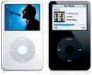
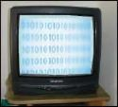
TV, Media & Cultural Production
A carrier for communication & consumer goods such as ad, TV, media, entertainment, books, etc…
Institutional systems & social organizations
Technological determinism
The medium is the message
Marshall McLuhan

Slide 7
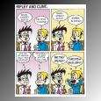
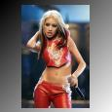
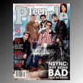
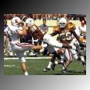
“Popular culture dominates the aestheticization of everyday life.” Featherstone, M.(1991). Consumer culture and postmodernism
Notes:
The dominant voice of our culture is the radiation of a Radio, MTV, Movie nation. We’re in a time where the visual is subjected to the political economy of the media. Impressionable, youth audiences consume mass messages loaded with invested interests and ideologies. Now, these pervasive storytellers have overwritten and replaced traditional forms of values and meaning making that once originated in community, family and religion.

Slide 8
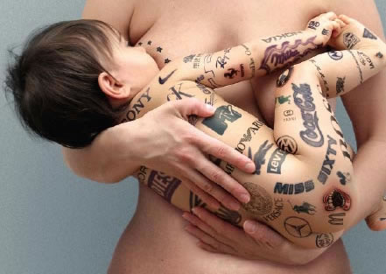

Slide 9
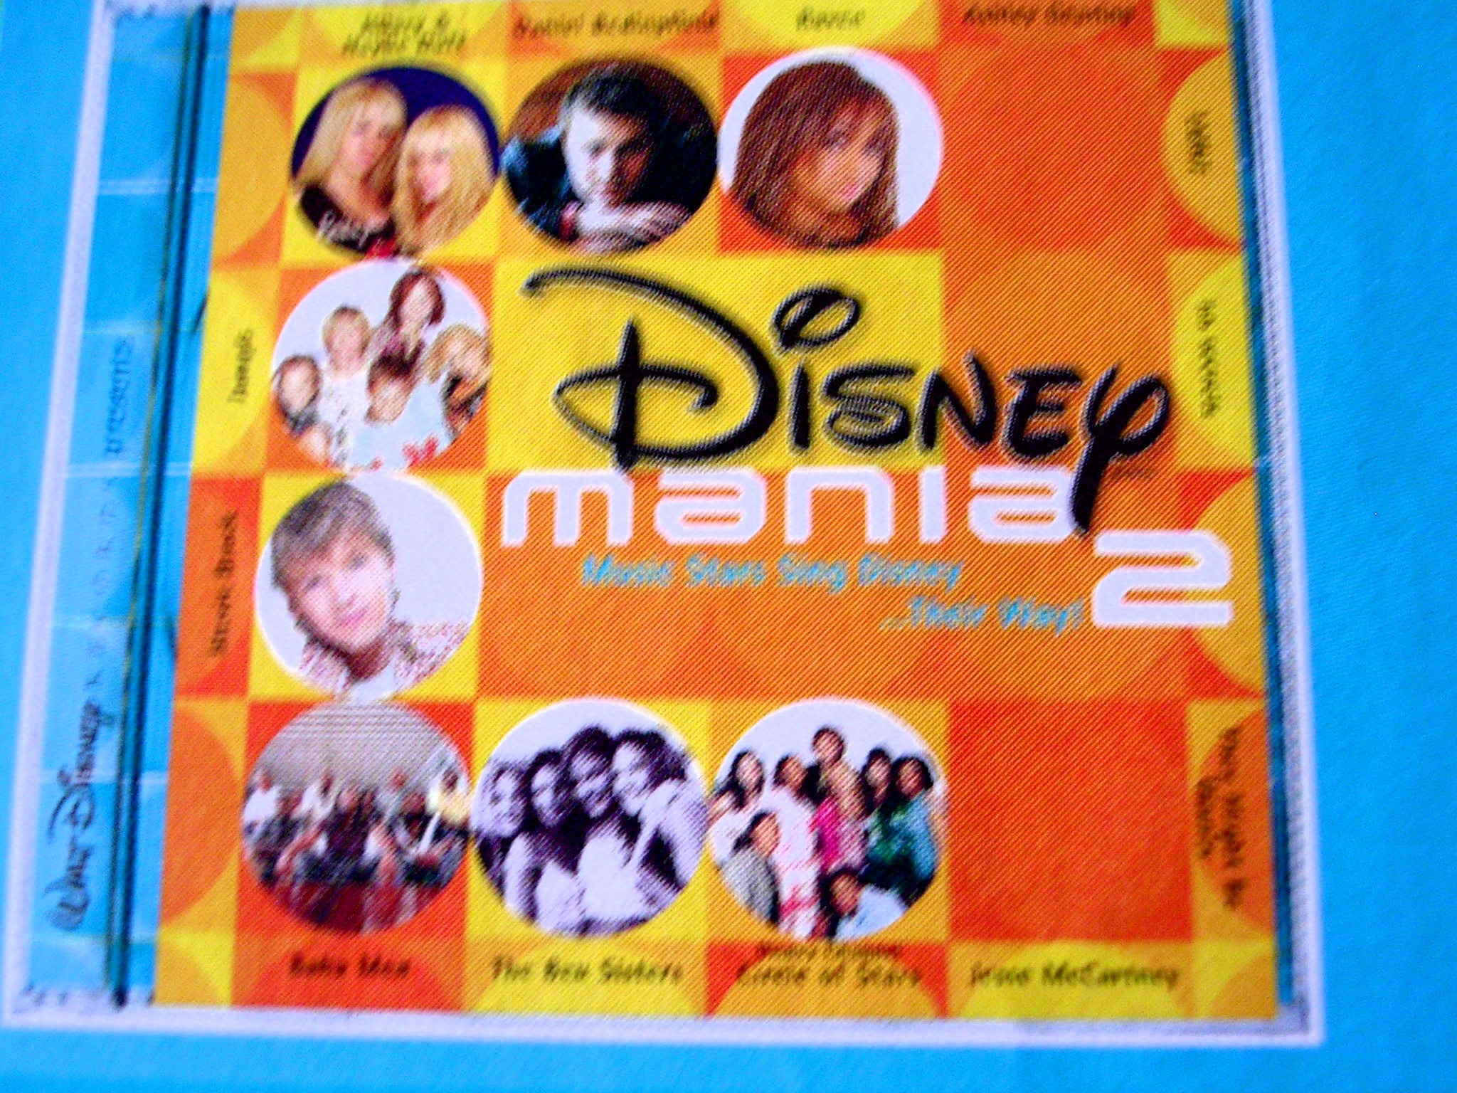
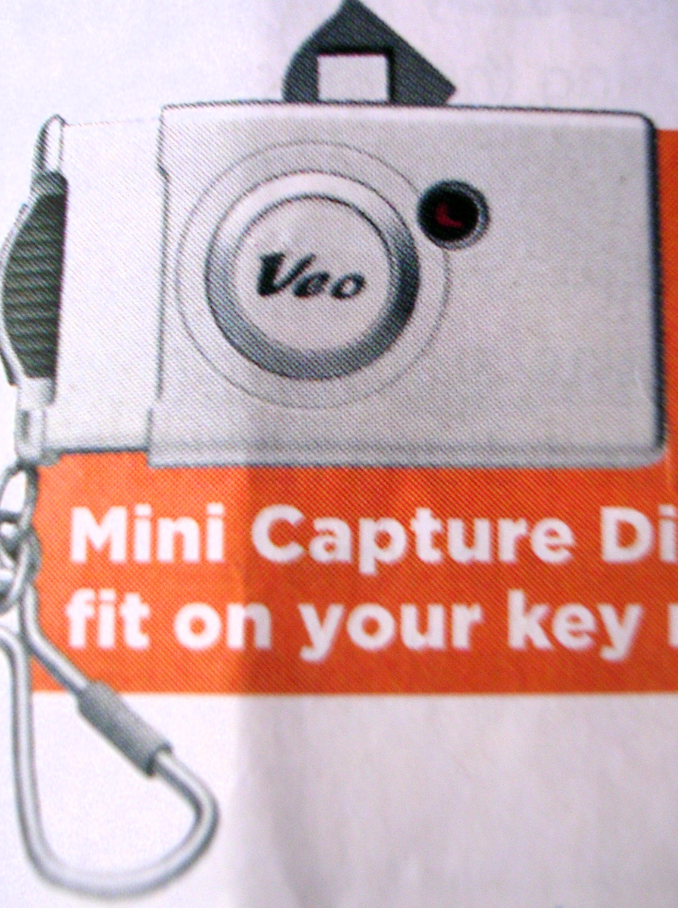
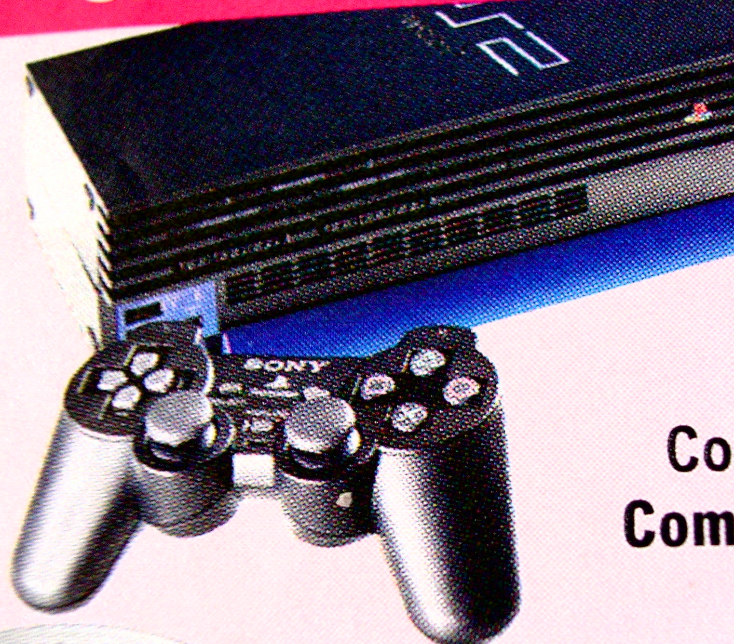
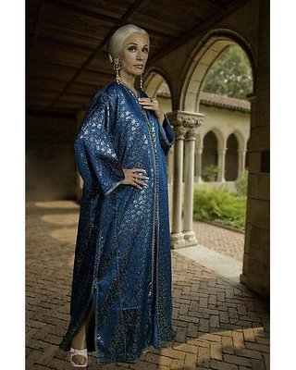
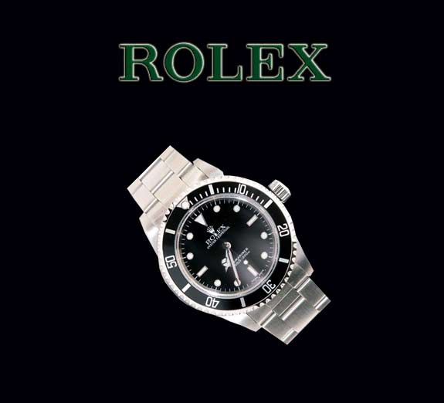
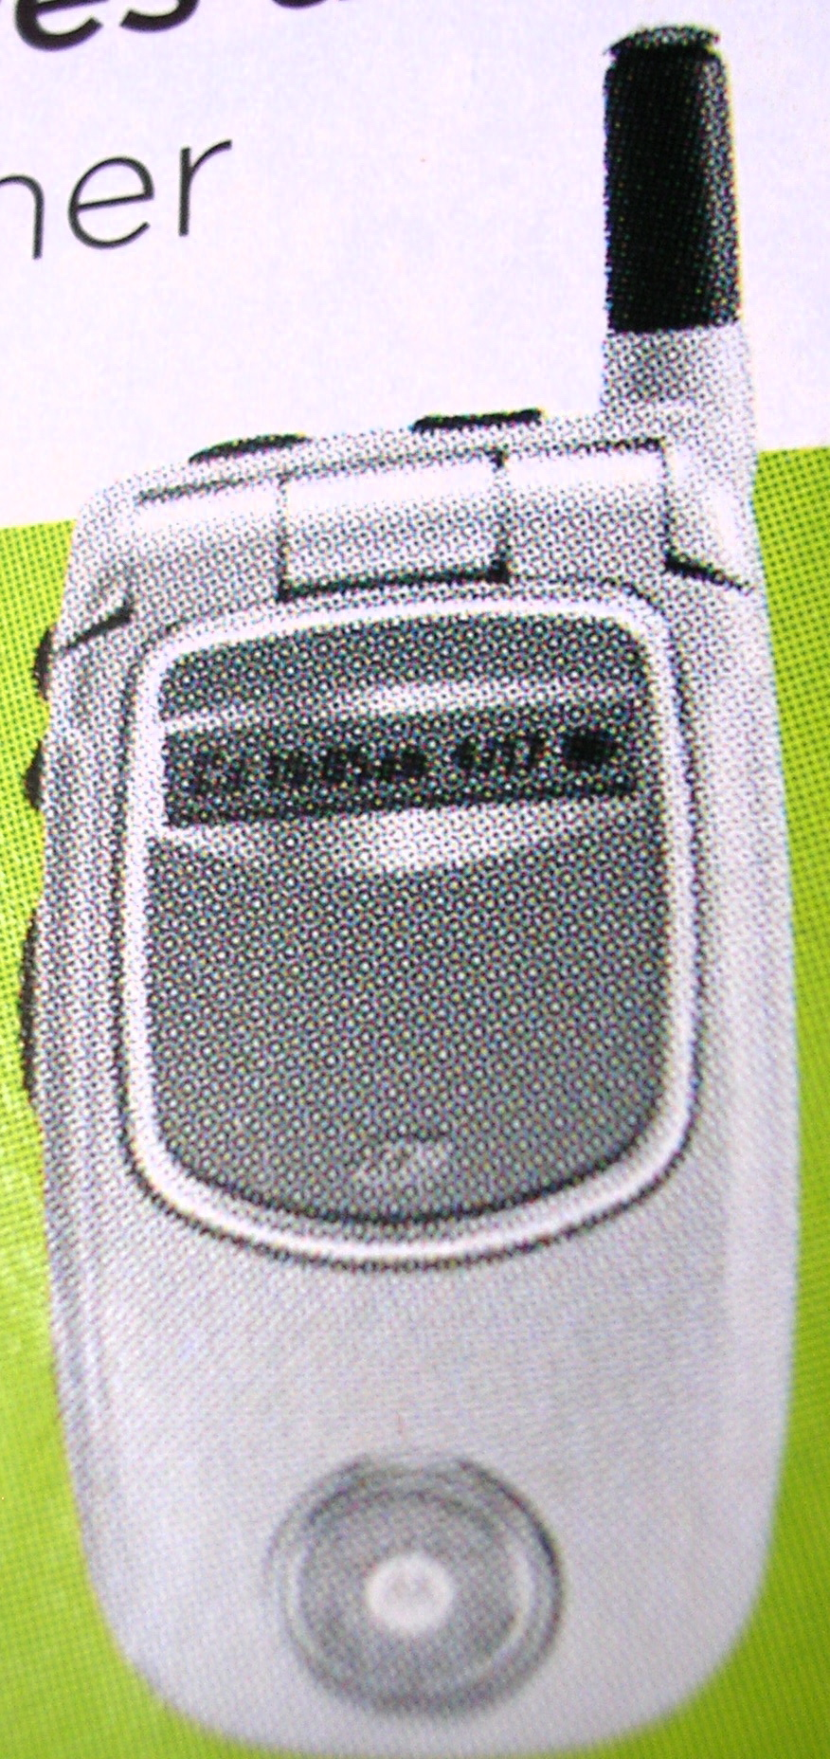
Myths about the American Dream & “The Goodlife”

Slide 10
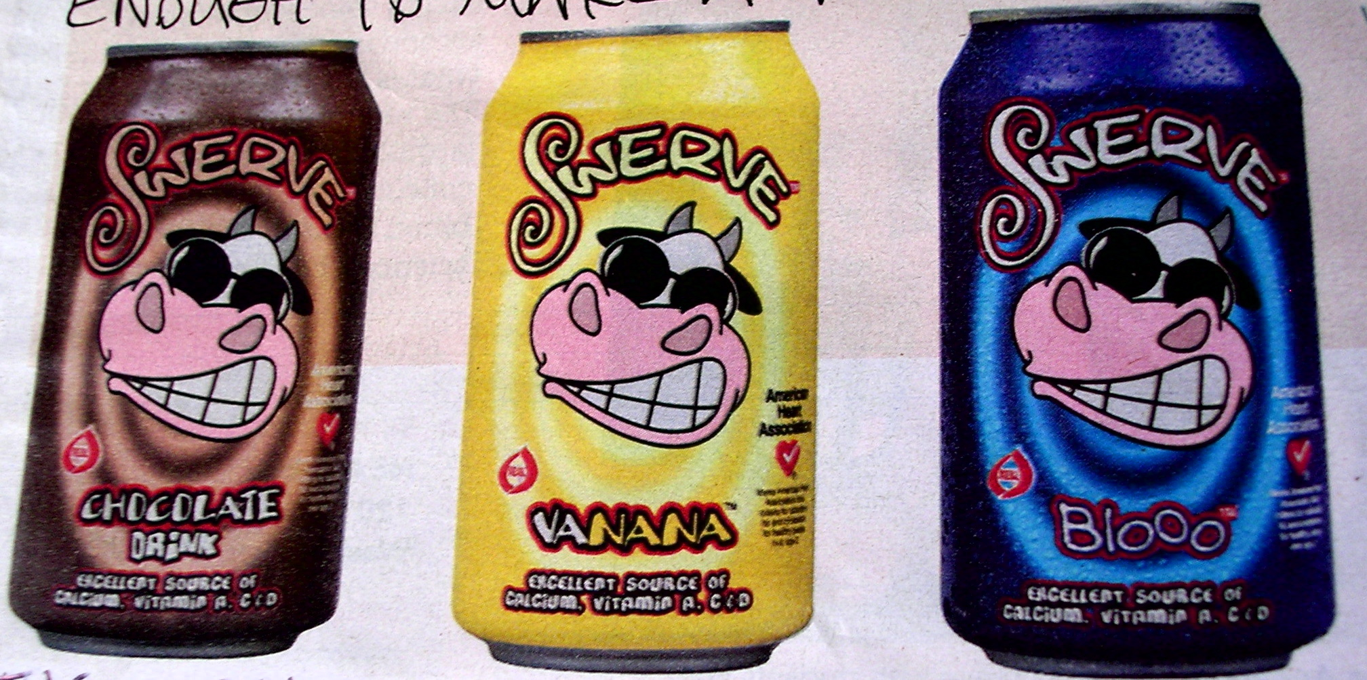
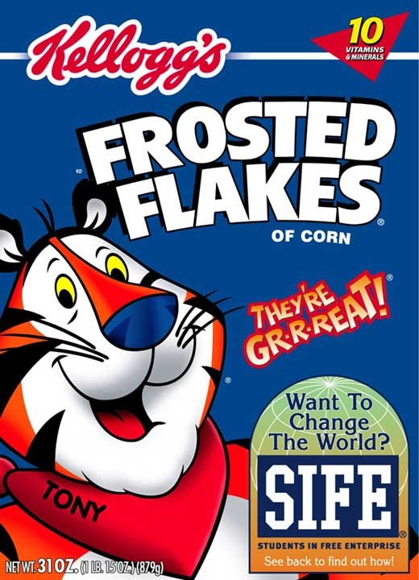
Myths about Health
& Nutrition

Slide 11
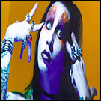
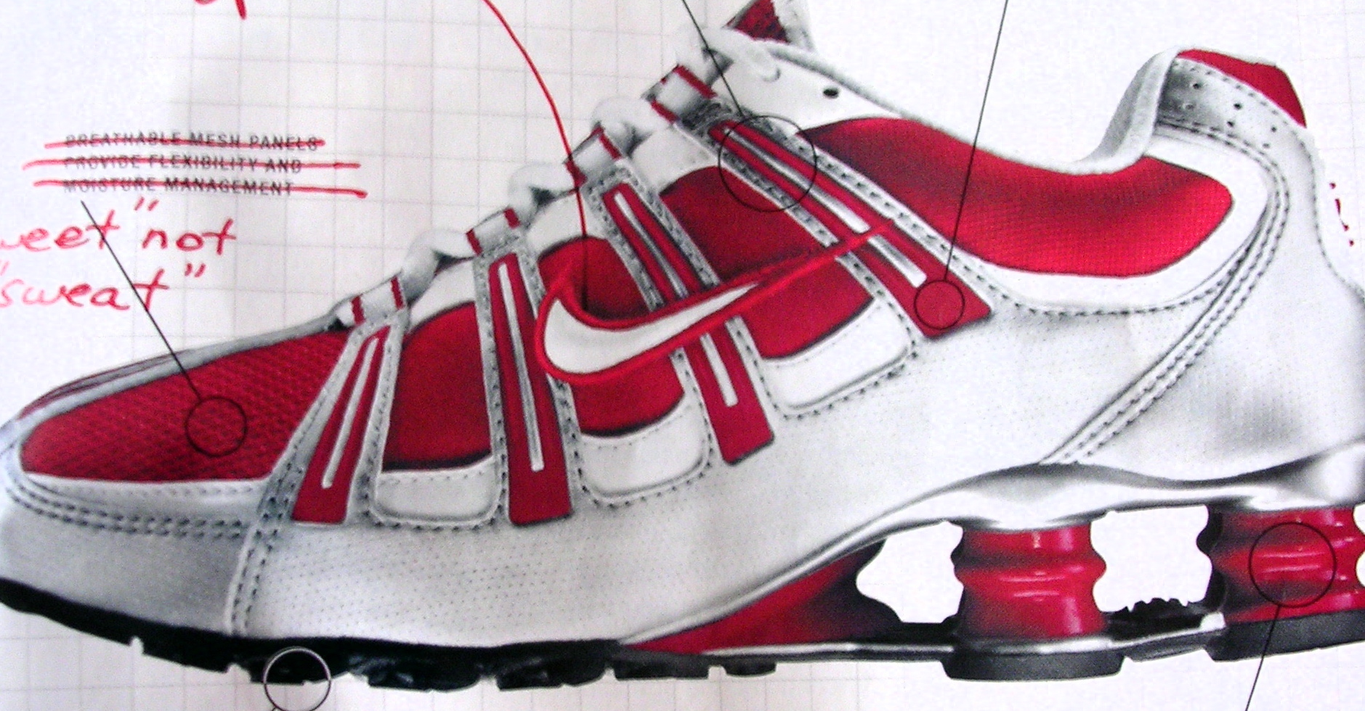
Media Teaches about what is “Cool” & socially acceptable
Notes:
While Cool can be defined in terms of surface appearances and status symbols and experiences associated with hottest and latest commodities. it is more importantly connected to the quest for meaning that is contained in a controllable and self-determined form. Knowledge of image, appearance, or attitude is modeled by us as it is mirrored in the sea of visual culture.

Slide 12
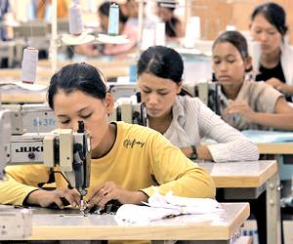
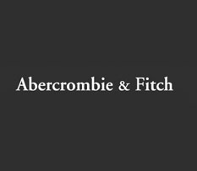
Brand Identities

Slide 15
Grant Wood, American Gothic

Slide 17
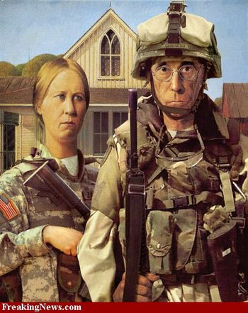

Slide 19
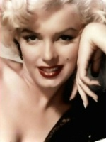
ICONS as Myth Makers
Symbols of fame & worship
Andy Warhol. (American, 1928-1987). Gold Marilyn Monroe.
1962. Silkscreen ink on synthetic polymer paint on canvas,

Slide 20
Cultural production & reproduction/ mass distributed
Warhol Diptych, 1962 Acrylic silkscreen print on canvas

Slide 21
Cultural appropriation
For whom is this an icon of appeal or desire?
For whom is it not?

Slide 22
2008
2000

Slide 23
What do you see?

Slide 24
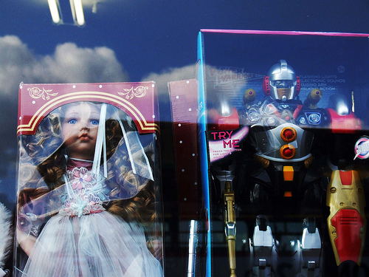
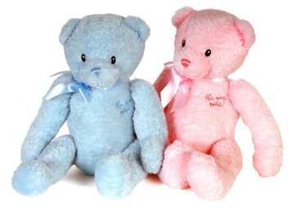
Myths about what is means to be a girl or a boy

Slide 25
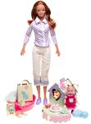
Myths about how a woman should act, treat others, and be focused upon & concerned with

Slide 26
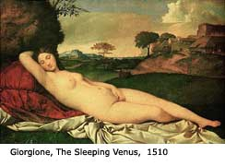
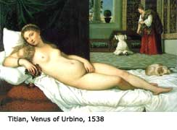
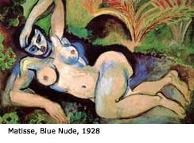
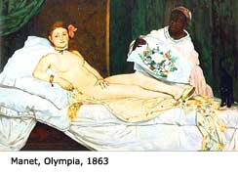
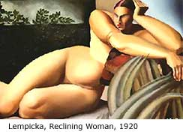
The Male Artist’s
Gaze

Slide 28
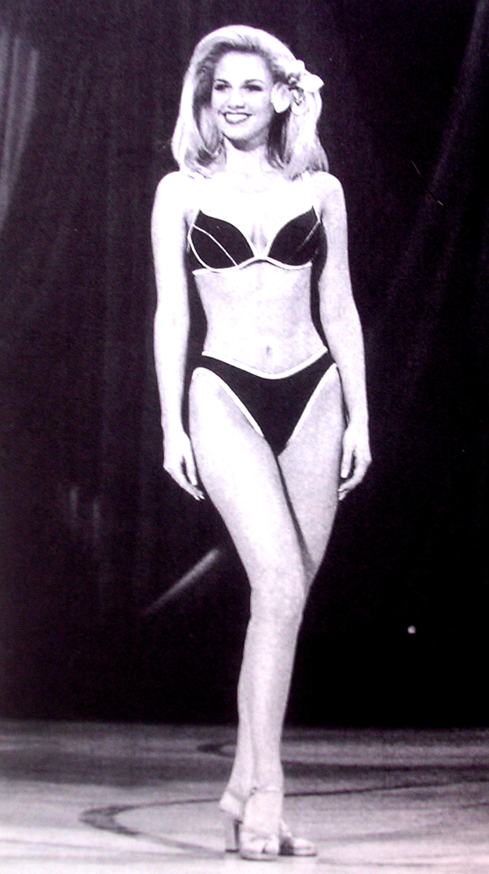
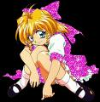
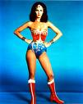
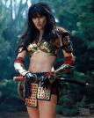
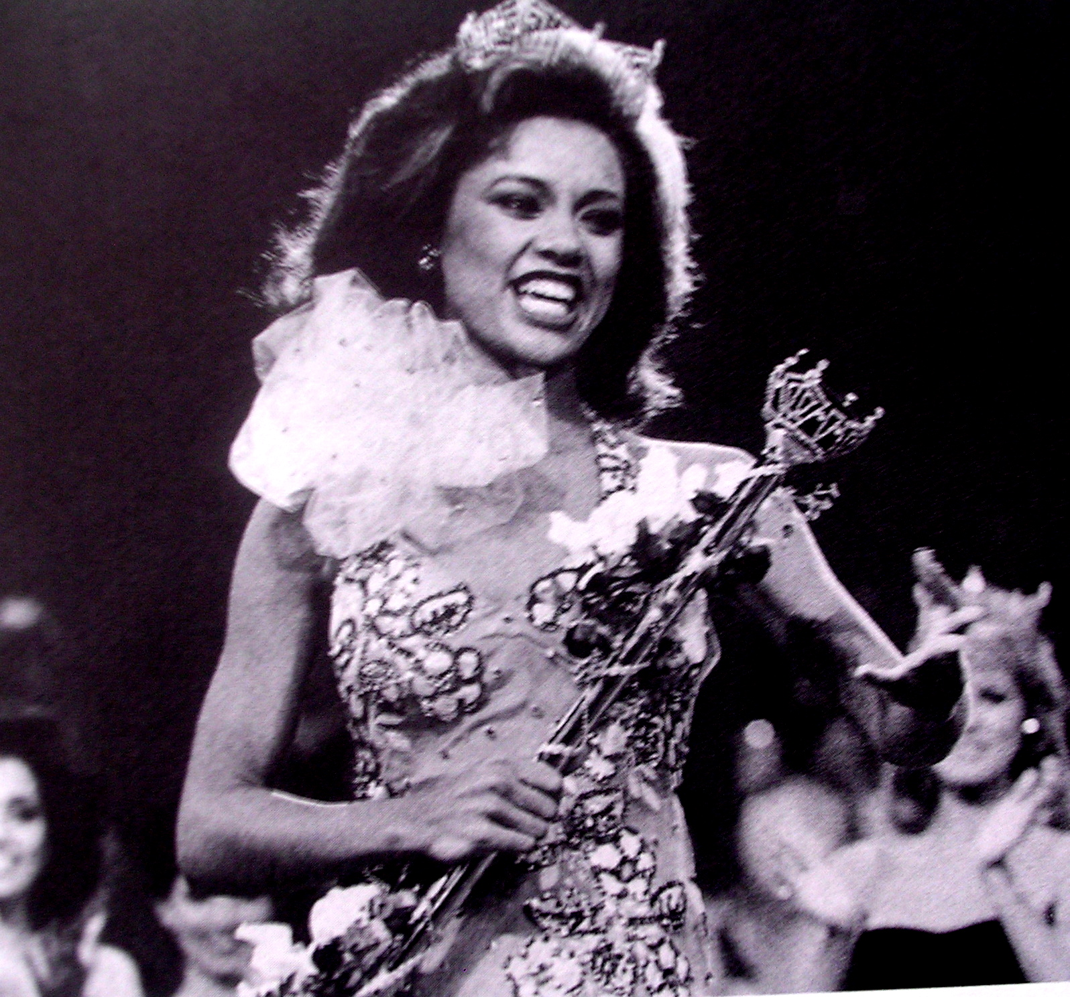
Myths about Social Roles, Appearance, Sexuality
Passive Dolls, Pleasure-producing Beauties

Slide 31
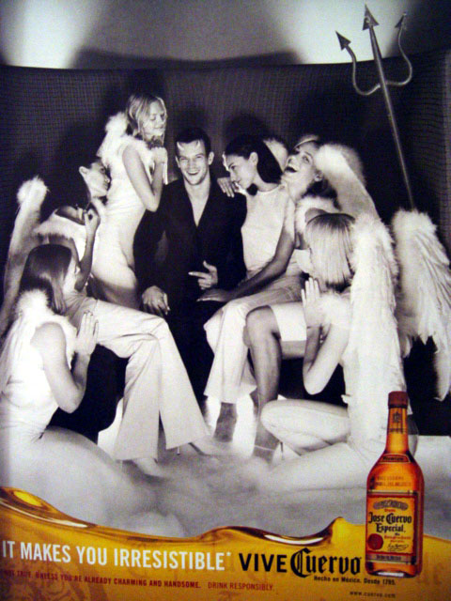
Myths about Gender Roles

Slide 32
DOLLS?

Slide 33
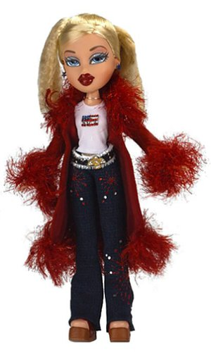
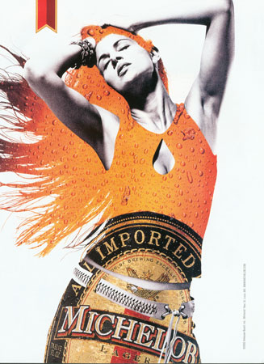
Sexualized DOLLS & OBJECTS

Slide 34
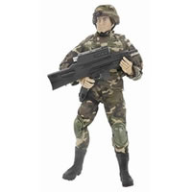
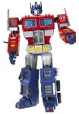
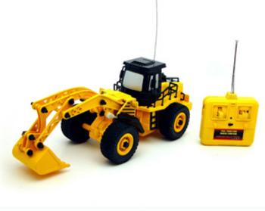
Myths about how a man should behave,
treat others, and be concerned with?

Slide 35
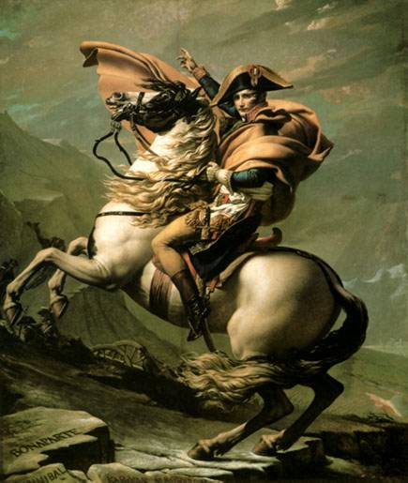
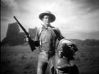
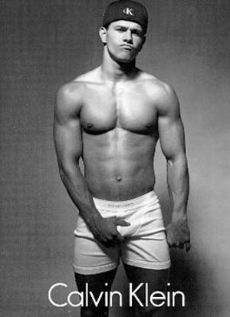

Slide 36
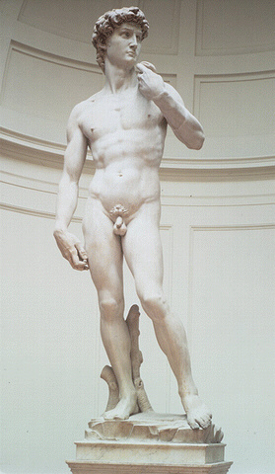
Ideal Male Beauty: square jaw,
“cut” bod
virility(sexual potency)

Slide 40
Myths of the “Tough Guise”
Sylvester Stallone
in Rambo
Arnold Swatrznegger and Grace Jones in
Conaan the Barbarian, 1985
Tasker, Y. (1993). Spectacular bodies: Gender, genre and action cinema. New York:
Routledge.

Slide 41
Gender Myths & Stereotypes about people who
“Don’t” fit Social Norms

Slide 42
Myths about Love & Romance
Notes:
While Cool can be defined in terms of surface appearances and status symbols and experiences associated with hottest and latest commodities. it is more importantly connected to the quest for meaning that is contained in a controllable and self-determined form. Knowledge of image, appearance, or attitude is modeled by us as it is mirrored in the sea of visual culture.

Slide 43
Notes:
Or here? This ad found in Seventeen magazine for Pepe Jeans:
How are discourses on gender, race, desire and the objectification of bodies and youth reinforced and defined for teen audiences? How are the realities of promiscuity, HIV/aids, and teen pregnancy oblitrerated. Once again, what has been emptied out and replaced by a new cool ethic?

Slide 46
Myths & Stereotypes about “the Other”

Slide 47
Aunt Jemima, 1889
Myths about Race, Position and Role in Society
The stereotype of “the Mammy-maid” who lives to nurture, clean,
cook for whites

Slide 48
Myths about Abilities or Academic Intelligence

Slide 51
Myths about what ethnic features are most desirable and accepted in “Mainstream” American Culture”
European, Lighter Features & Skin= Higher Class/Status?

Slide 52
Assimilation Civilization Fund Act, 1819
Christian Boarding School, PA, 1900
Denied of native identity: language, religion, clothing, food, etc

Slide 53
Post Pearl Harbor attack 1941-1946
National Security relocated 110,000 to
Internment camps

Slide 54
Abu Ghraib Prison

Slide 55
News Media
Who Constructs and shapes
our perceptions?
2012, HBO Film: Game Change

Slide 56
Visual Literacy: 3 modes of reading
Dominant Reading
accept the message given
Negotiated Reading
question the context
Oppositional Reading
reject the ideas, myths

Slide 58
Decoding A Magazine Cover
Describe & Compare the CODES: body language/ Eye contact/ Facial expression/
Clothing/ Make up/ Background/ Camera angle/ Lighting/ …

Slide 59
Lesson Idea: Create Own Magazine Cover
Spoof the style of a popular magazine
Rename in same font
Important Cover Story Feature
Students use cameras and take photos for feature story

Slide 60
Decode an Print Advertisement
Make Observations
List 5 adjectives that describe it
Describe your response or feeling (connotations)
Describe what you see (denotations) products, colors, copy, font, people, gender
Determine the Purpose of the Ad
Product being sold
Associations created-persuasive tactics used?
Determine the Assumptions in the ad
Men are.. Women are…
Wealthy people are.. Working class are..
Latinos are,… Asians are..
Consider Consequences of the Ad
Creates unrealistic expectations?
Undermine social change?
Citizen vs. consumer?

Slide 61
Marketing Minds: Branding a Towel to sell.
Goal: Help kids Understand
Target Marketing
Create an advertising campaign for a plain white hand towel which will motivate your assigned target group to buy this product.
Niche Market: Teen girls, preschoolers, janitors, atheletes, teachers
Reflection:
Group characteristics
Principles of persuasion
Use or rejection of stereotypes

Slide 62
Culture Jamming

Slide 64
Ad Busting (Adbusters.org) Juxtapose images to show a “myth” or unspoken truth

Slide 66
Create An Ad Buster
Provide print ads for students
Use paint and markers to alter it in ways that change and counters it meaning or dominate myth.
Add to, layer over, juxtapose with another image, change tag lines or texts.
Using New Media: Teach Photoshop techniques and scan in/alter image & text.

